Slide 1

Robotics final presentation
Motion control on Turtlebot
Advisors: - Eng. Ralph Seulin
- PhD Std. Cansen Jiang
- Raphael Duverne
By Antoine Merlet – Kevin Descharrieres 17/05/17
Notes:
30s (K)

Slide 2
Summary
Introduction
Methods & Setup
Control of the robot
  Basic moves
  Sensors
  SLAM and AMCL
ROSifing the PhantomX
Conclusion & future work
Demonstration
Antoine Merlet – Kevin Descharrieres 17/05/17
Notes:
30s (A)

Slide 3
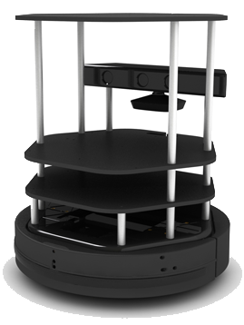

I. Introduction
Discovery:
  ROS middleware
  TurtleBot hardware
Innovation:
  TurtleBot and PhantomX arm pincher merging
Antoine Merlet – Kevin Descharrieres 17/05/17
Notes:
45s (A)

Slide 4


II. Methods and Setup
Network management:
  Predefined network setup
  SSH remote control
  Bashrc file modification
Workstation
Turtlebot
SSH
Antoine Merlet – Kevin Descharrieres 17/05/17
Notes:
45s (A)

Slide 5
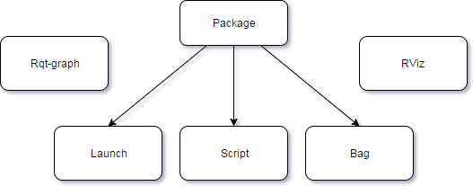
II. Methods and Setup
ROS organization:
  Strict layout
  Bag file recording
  Powerful management tools
  ROS by example book
Antoine Merlet – Kevin Descharrieres 17/05/17
Notes:
45s (A)

Slide 6
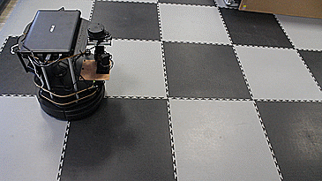
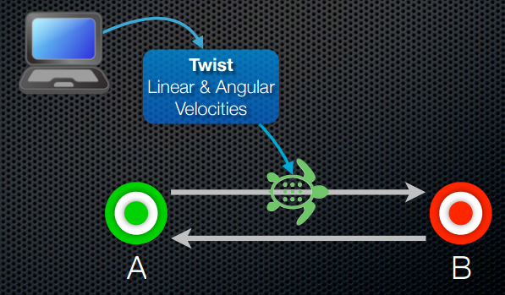
III. Control of the robot\Basic moves
Moving forward by publishing a twist message
Antoine Merlet – Kevin Descharrieres 17/05/17
Notes:
45s (A)

Slide 7
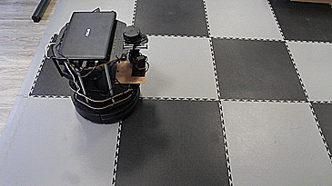
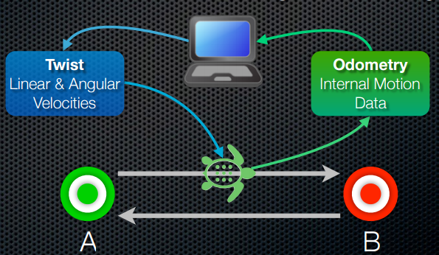
III. Control of the robot\Basic moves
Improving accuracy using odometry
Antoine Merlet – Kevin Descharrieres 17/05/17
Notes:
45s (A)

Slide 8
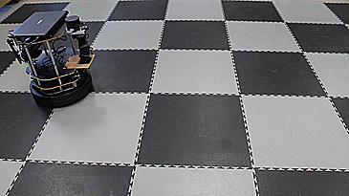
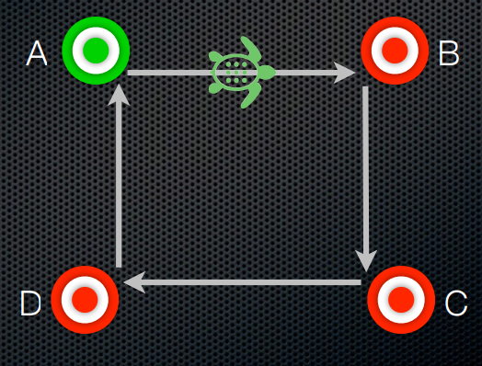
III. Control of the robot\Basic moves
Performing a precise square-shaped movement
Antoine Merlet – Kevin Descharrieres 17/05/17
Notes:
45s (A)

Slide 9
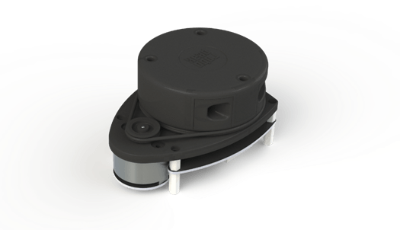
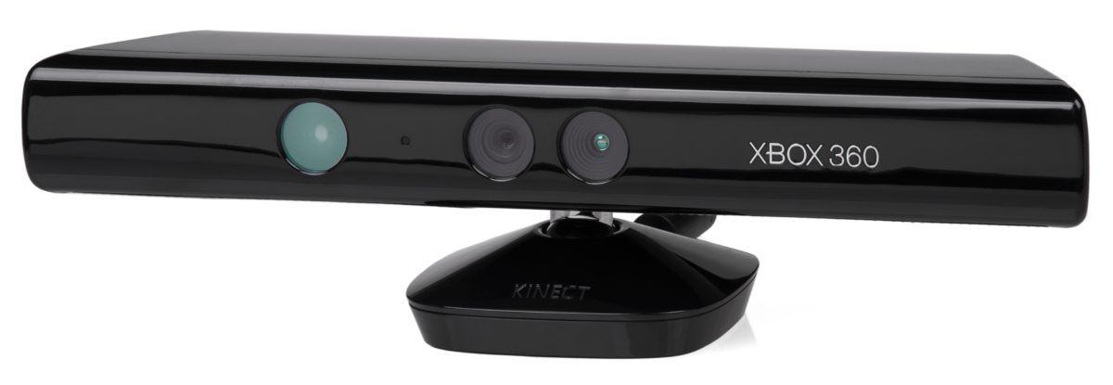
III. Control of the robot\Sensors
Internal sensors:
  Bump, cliff, gyroscope, …
External sensors:
  Kinect
  RPLIDAR
Antoine Merlet – Kevin Descharrieres 17/05/17
Notes:
45s (A)

Slide 10
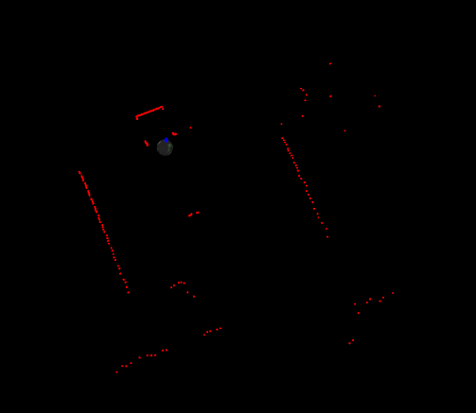
III. Control of the robot\Sensors
RPLIDAR:
  “Plugin”
  Spatial information
  Feedback using Rviz
  Localization sensing
  Mapping
Antoine Merlet – Kevin Descharrieres 17/05/17
Notes:
45s (A)

Slide 11
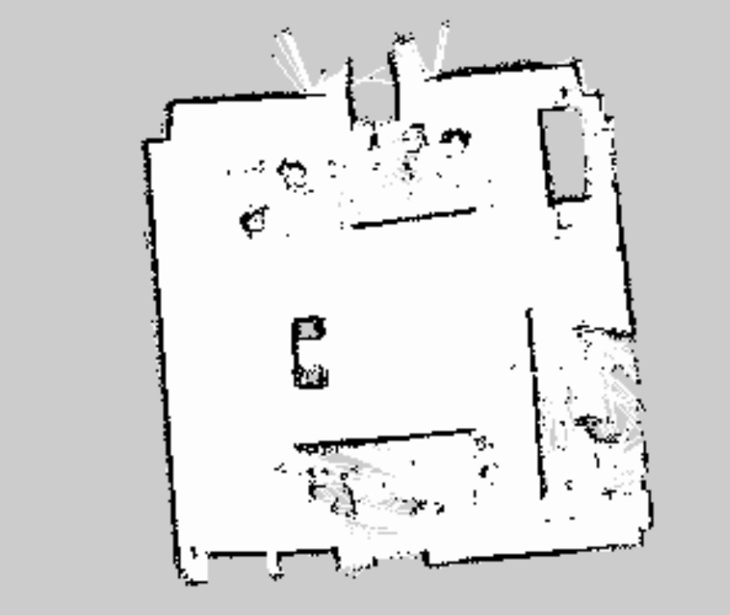
III. Control of the robot\SLAM and AMCL
SLAM: Simultaneous Localization And Mapping
AMCL is a probabilistic localization system for a robot moving in 2D
Antoine Merlet – Kevin Descharrieres 17/05/17
Notes:
45s (A)

Slide 12
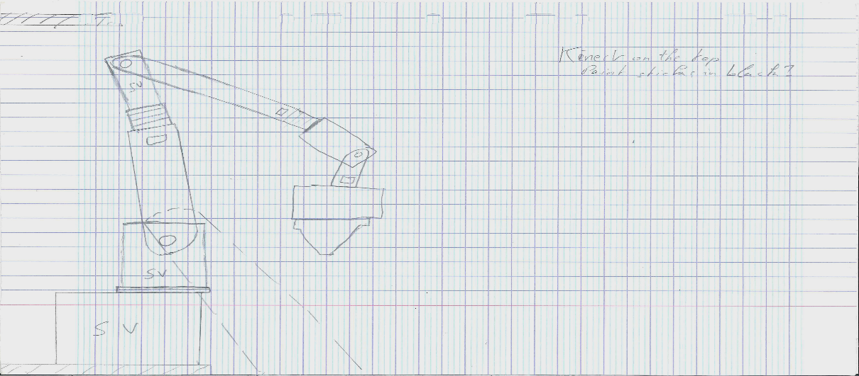
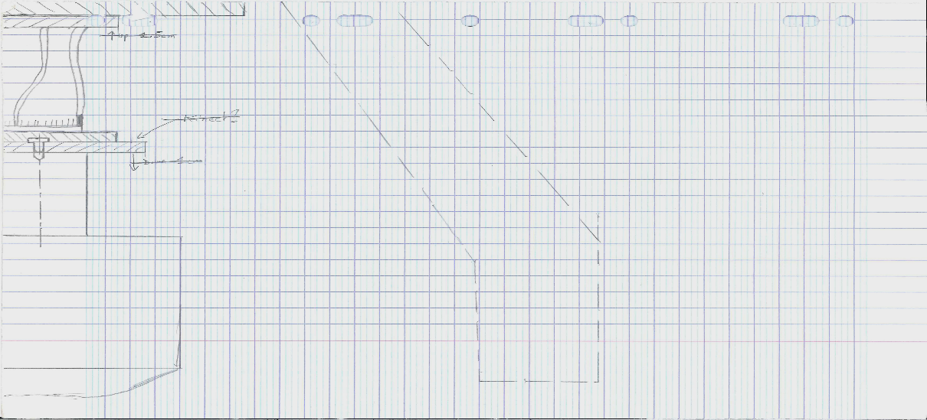
IV. ROSifing the PhantomX
Homemade design:
  Position of the arm on the TurtleBot
  1 to 1 scale between the arm and the TurtleBot
ARM
AMPLITUDE
Antoine Merlet – Kevin Descharrieres 17/05/17
Notes:
45s (A)

Slide 13
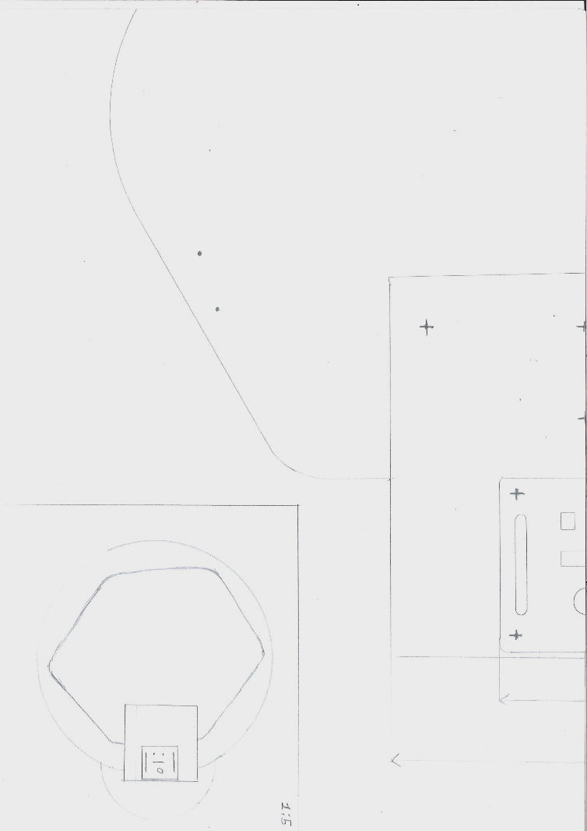
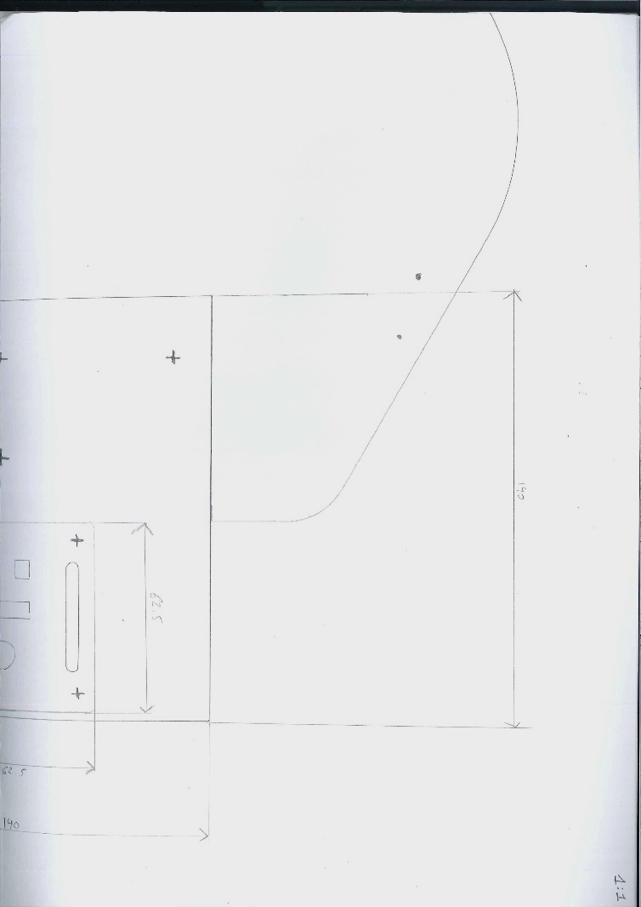
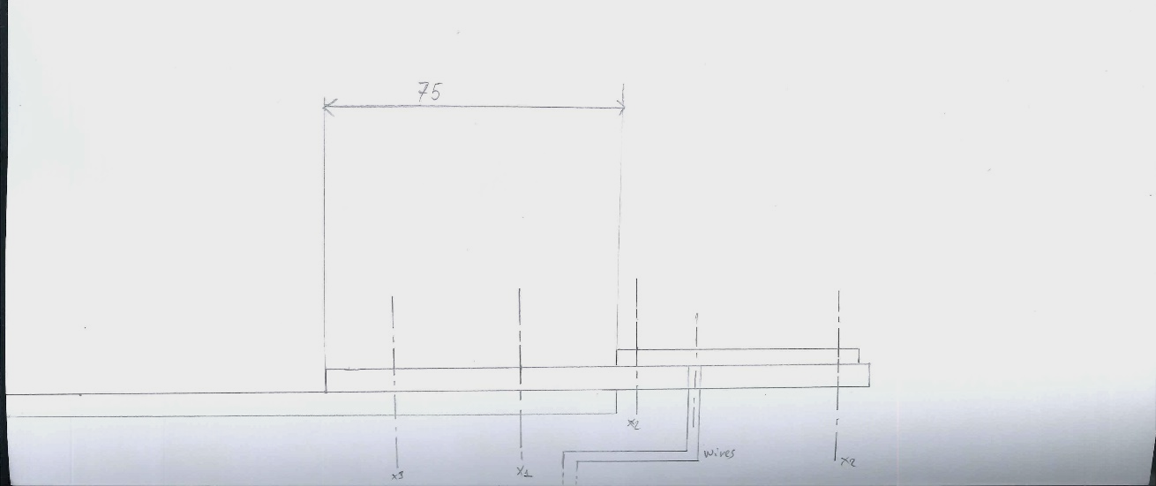
IV. ROSifing the PhantomX
Homemade design
  Support plate between the TurtleBot and the PhantomX Arm Pincher
75
62.5
140
Antoine Merlet – Kevin Descharrieres 17/05/17
Notes:
45s (A)

Slide 14
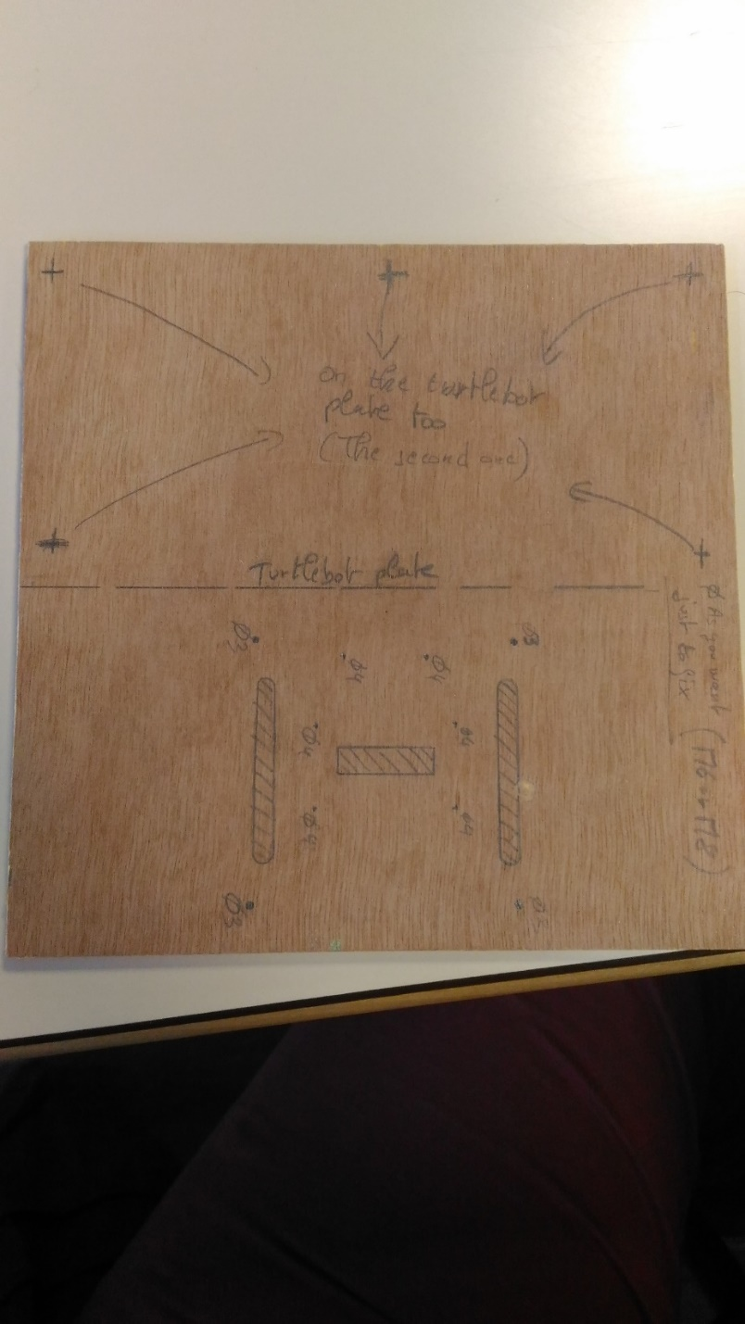
IV. ROSifing the PhantomX
Homemade design
  Designed transferred onto the support before preparation
Antoine Merlet – Kevin Descharrieres 17/05/17
Notes:
45s (A)

Slide 15
IV. ROSifing the PhantomX
New alimentation setup
Computer
Computer
Datas
Datas
Arduino
Datas
Alim
Router
Router
Datas
Alim
Datas
Alim
Alim
Base
Base
Antoine Merlet – Kevin Descharrieres 17/05/17
Notes:
2m30(K)
1m30(A)

Slide 16
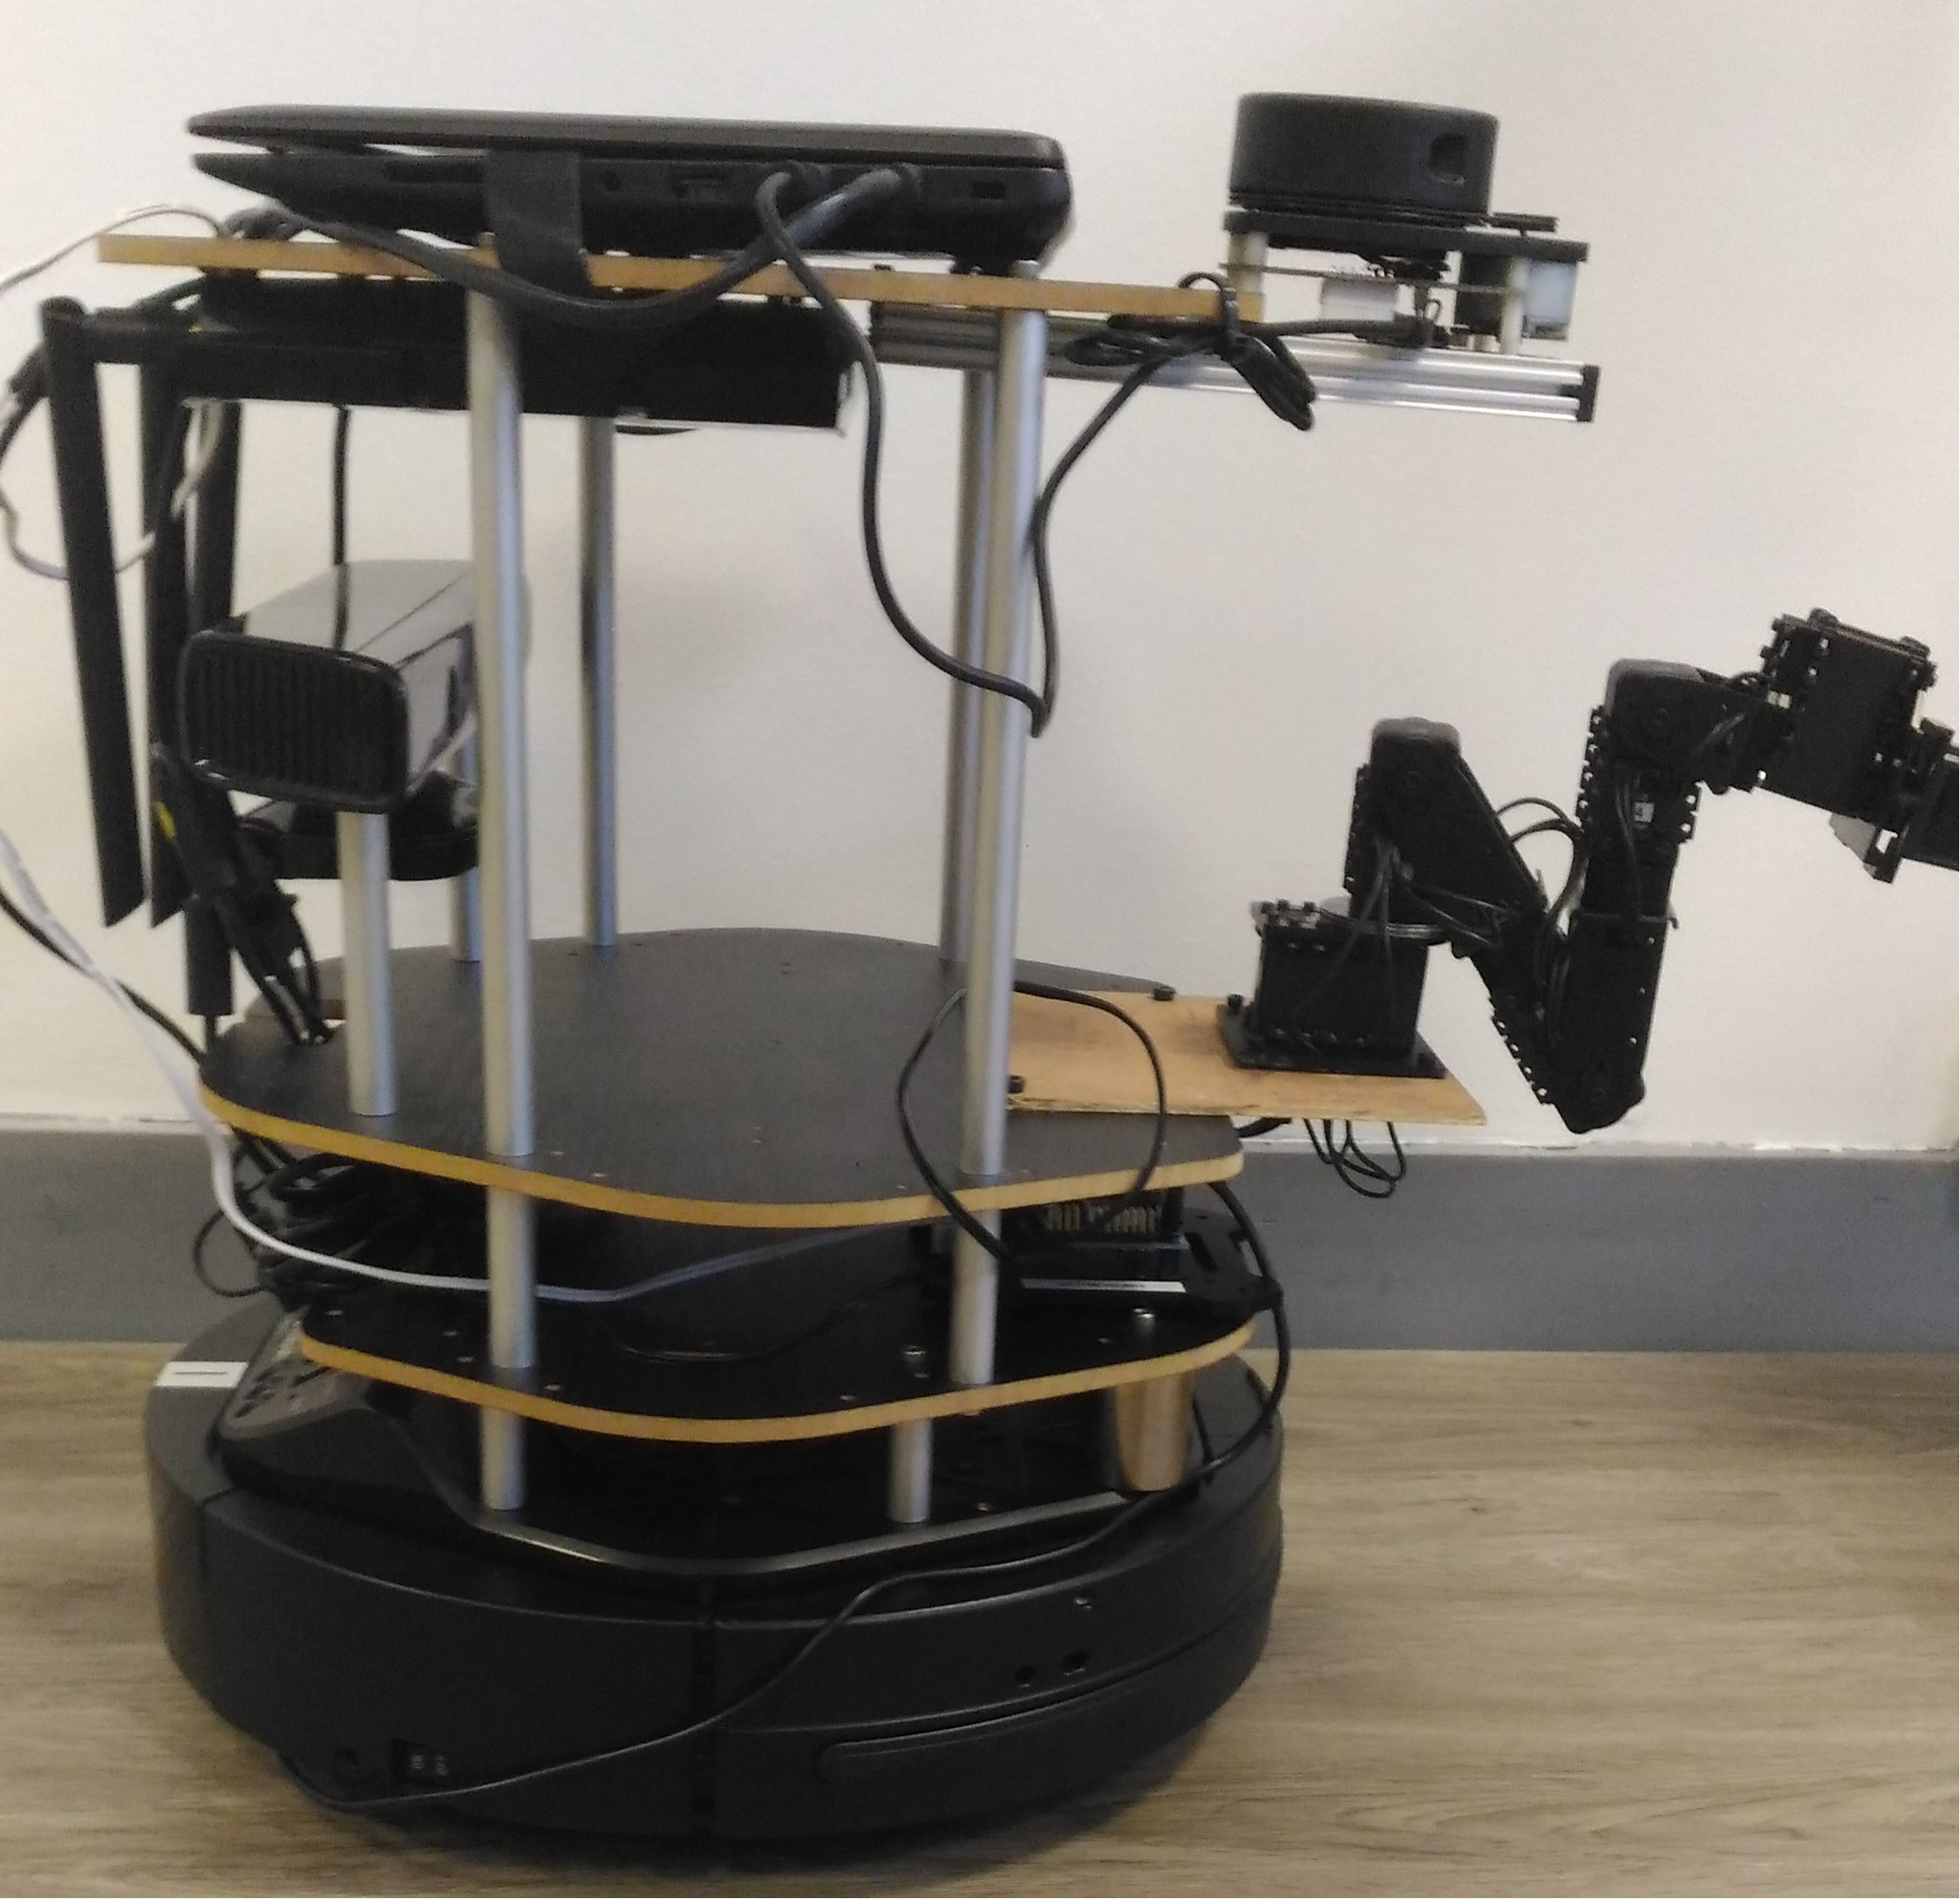
V. Conclusion & future work
Results:
  Moving robot
  Gmapping
  First step if the PhantomX ROSification
Moving forward:
  Gmapping settings improvement
  Asynchronous control of the arm + TutleBot
Antoine Merlet – Kevin Descharrieres 17/05/17
Notes:
45s (A)

Slide 17
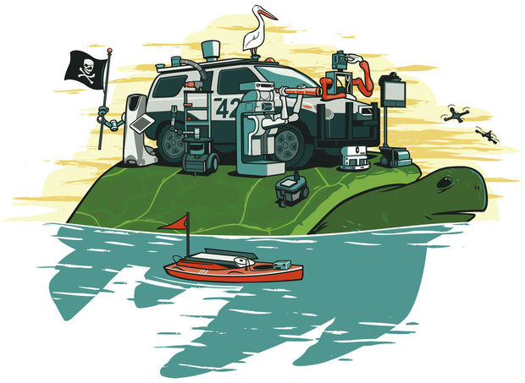

Thank you !
Question(s)?
Antoine Merlet – Kevin Descharrieres 17/05/17
Notes:
45s (A)

Slide 18
VI. Demonstration 1
Live creation of the rooms' map using
Gmapping and a Joystick
Antoine Merlet – Kevin Descharrieres 17/05/17
Notes:
45s (A)

Slide 19
VI. Demonstration 2
Live creation of the rooms' map using Gmapping and
a Joystick with the kind participation of
our omnipotent and omniscient
Jury
Antoine Merlet – Kevin Descharrieres 17/05/17
Notes:
45s (A)

Slide 20
VI. Demonstration 2
Live creation of the rooms' map using Gmapping and
a Joystick with the kind participation of
our omnipotent and omniscient
Jury
Antoine Merlet – Kevin Descharrieres 17/05/17
Notes:
45s (A)

Slide 21
Thank you !
Question(s)?
Antoine Merlet – Kevin Descharrieres 17/05/17
Notes:
45s (A)

Slide 22
Sources
Page 3:
  Ros Logo: http://www.ros.org/wp-content/uploads/2013/10/rosorg-logo1.png
  TurtleBot: http://www.turtlebot.com/assets/images/turtlebot_2_lg.png
Page 4:
  Computer icon : http://simpleicon.com/wp-content/uploads/computer-5.png
  Arrow: http://www.clipartbest.com/cliparts/Rid/6qq/Rid6qq8nT.png
Page 9:
  Kinect: https://upload.wikimedia.org/wikipedia/commons/thumb/6/67/Xbox-360-Kinect-Standalone.png/1200px-Xbox-360-Kinect-Standalone.png
  RPLIDAR: https://i1.wp.com/makerfaire.com/wp-content/uploads/gravity_forms/20-a653962f213aebe54bfb85fc40955ae4/2015/02/image001.png?fit=750%2C500&strip=all
Page 17:
  Turtle Ros : https://cdn.instructables.com/FAI/YQBV/H3M6BTPR/FAIYQBVH3M6BTPR.MEDIUM.jpg
  Speech buble : http://www.pngall.com/wp-content/uploads/2016/07/Speech-Bubble-PNG-Picture.png
  All the images/diagrams not referenced here were produced by our team
Notes:
45s (A)

